Slide 1
Interbasin Transfer Update
LeToya Ogallo
Division of Water Resources
July 13, 2011

Slide 2
UPDATES
Neuse Regional Water and Sewer Authority
Kerr Lake Regional Water System
Brunswick County Public Utilities

Slide 3
Neuse Regional WASA
NRWASA indicated intent to pursue an IBT certificate in early 2010.
Session Law 2011-298 exempts transfers in the CCPCUA totaling 8 MGD from IBT requirements.
Effect of Session Law has yet to be fully determined.

Slide 4
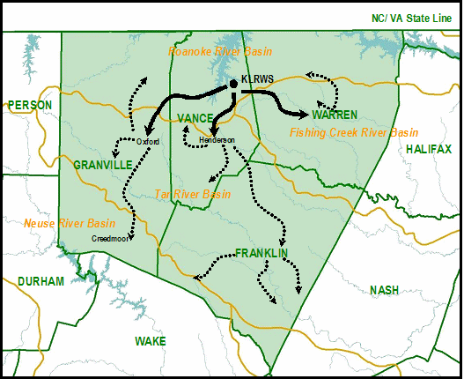
Kerr Lake Regional Water System Service Area
IBT Request
24 MGD from Roanoke to Tar and Fishing Creek
2.1 MGD from Roanoke to Neuse
Notes:
Oxford, Henderson and Warren County are partners in the KLRWS. Water sales to an additional 15 communities (not public water systems- the number of those has not been determined. Identified 20 surface water purchases as PWSS and over 200 groundwater systems).
Proposing to increase their existing interbasin transfer to account for future growth. This is not a request for additional allocation from Kerr Lake (USACE allocated the storage in 2005 giving them a 20 MGD average day withdrawal). Nearly all of the proposed increase is going to existing customers with the exception of creedmoor.
Currently transferring:
5 MGD from Roanoke to Tar and Fishing and
0.3 MGD from Roanoke to Neuse.
10 MGD is their grandfathered capacity.
Requesting:
24 MGD from Roanoke to Tar and Fishing and
2.1 from Roanoke to Neuse.

Slide 5
Kerr Lake Regional Water System
Draft EIS is currently being reviewed by applicant. Partners expect to submit DEIS for internal DWR review in 2011.
Notes:
Currently drafting text EIS
DWR has been working closely with the consultant to update the model- has taken a bit longer than expected due to challenges getting data from VA, but the model is moving forward.

Slide 6
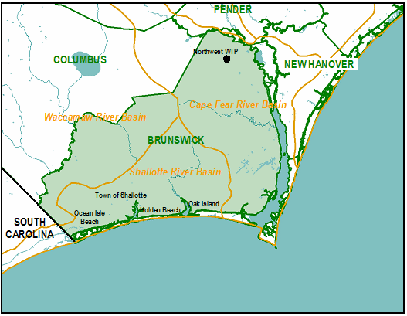
Brunswick County Service Area
IBT Request
18.35 MGD from Cape Fear to Shallotte
0.94 MGD from Cape Fear to Waccamaw
Notes:
Brunswick County provides water for over 30,000 retail customers and 11 wholesale customers (not public water systems- 15 surface water purchases and many groundwater systems).
They have an existing grandfathered capacity of 10.44 MGD to the Shallotte and Waccamaw. Requesting 18.35 to the Shallotte and 0.94 to the Waccamaw.

Slide 7
Brunswick County
County is moving forward with development of environmental document in Fall 2011.

Slide 8
Questions?
For additional information about interbasin transfer:
Contact toya.f.ogallo@ncdenr.gov
or
Visit us online at http://www.ncwater.org/Permits_and_Registration/Interbasin_Transfer/

Slide 9
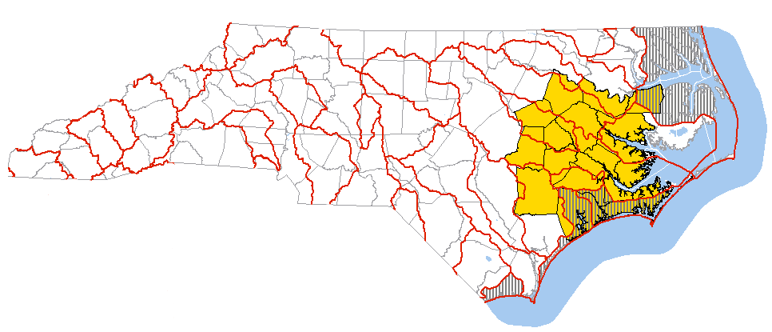
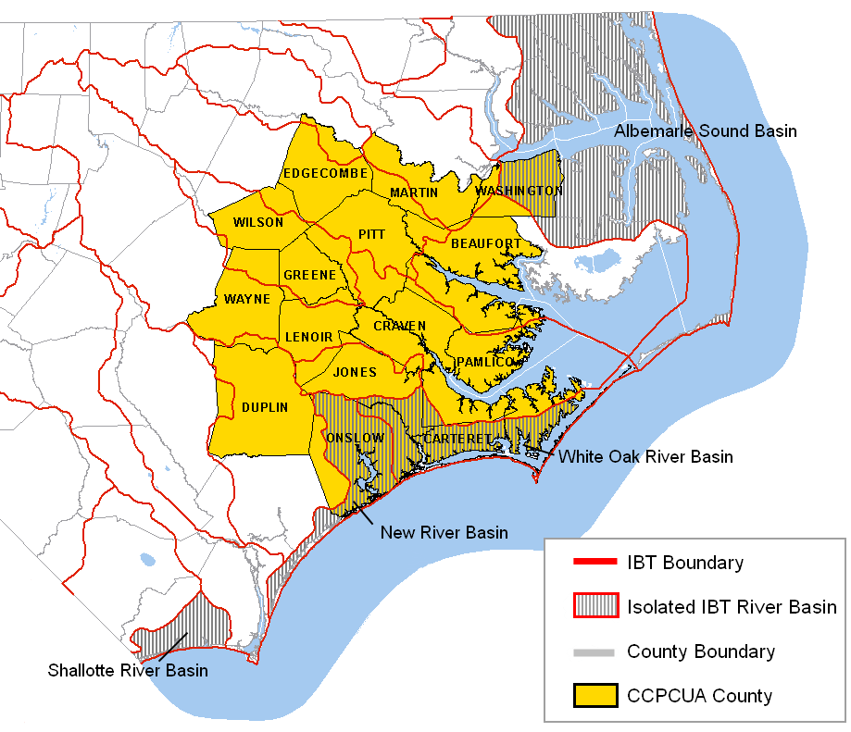
Notes:
This graphic shows areas of the State Falling Under the .22I Requirements For Obtaining an IBT Certificate

